Slide 1
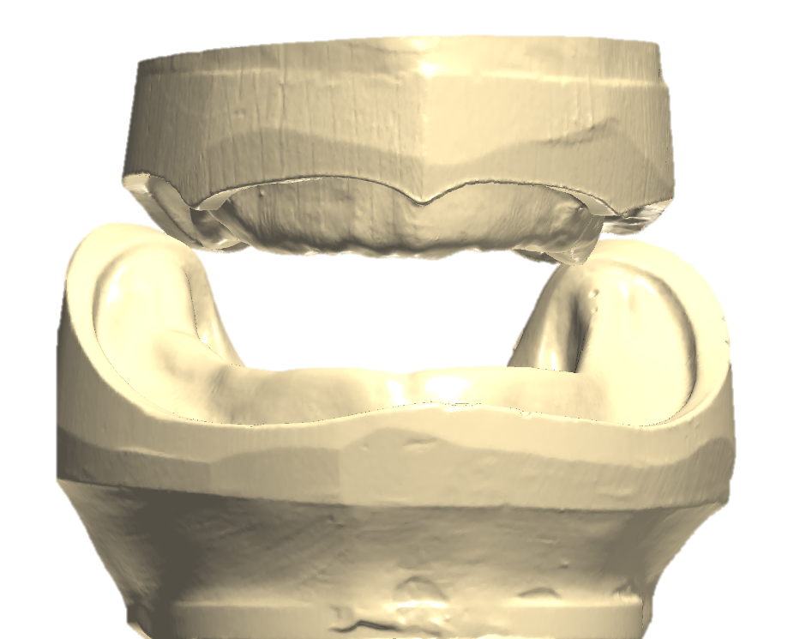
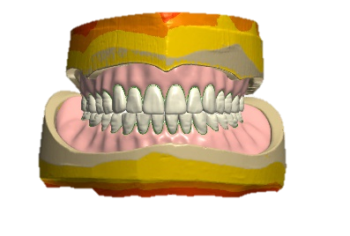
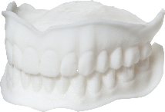
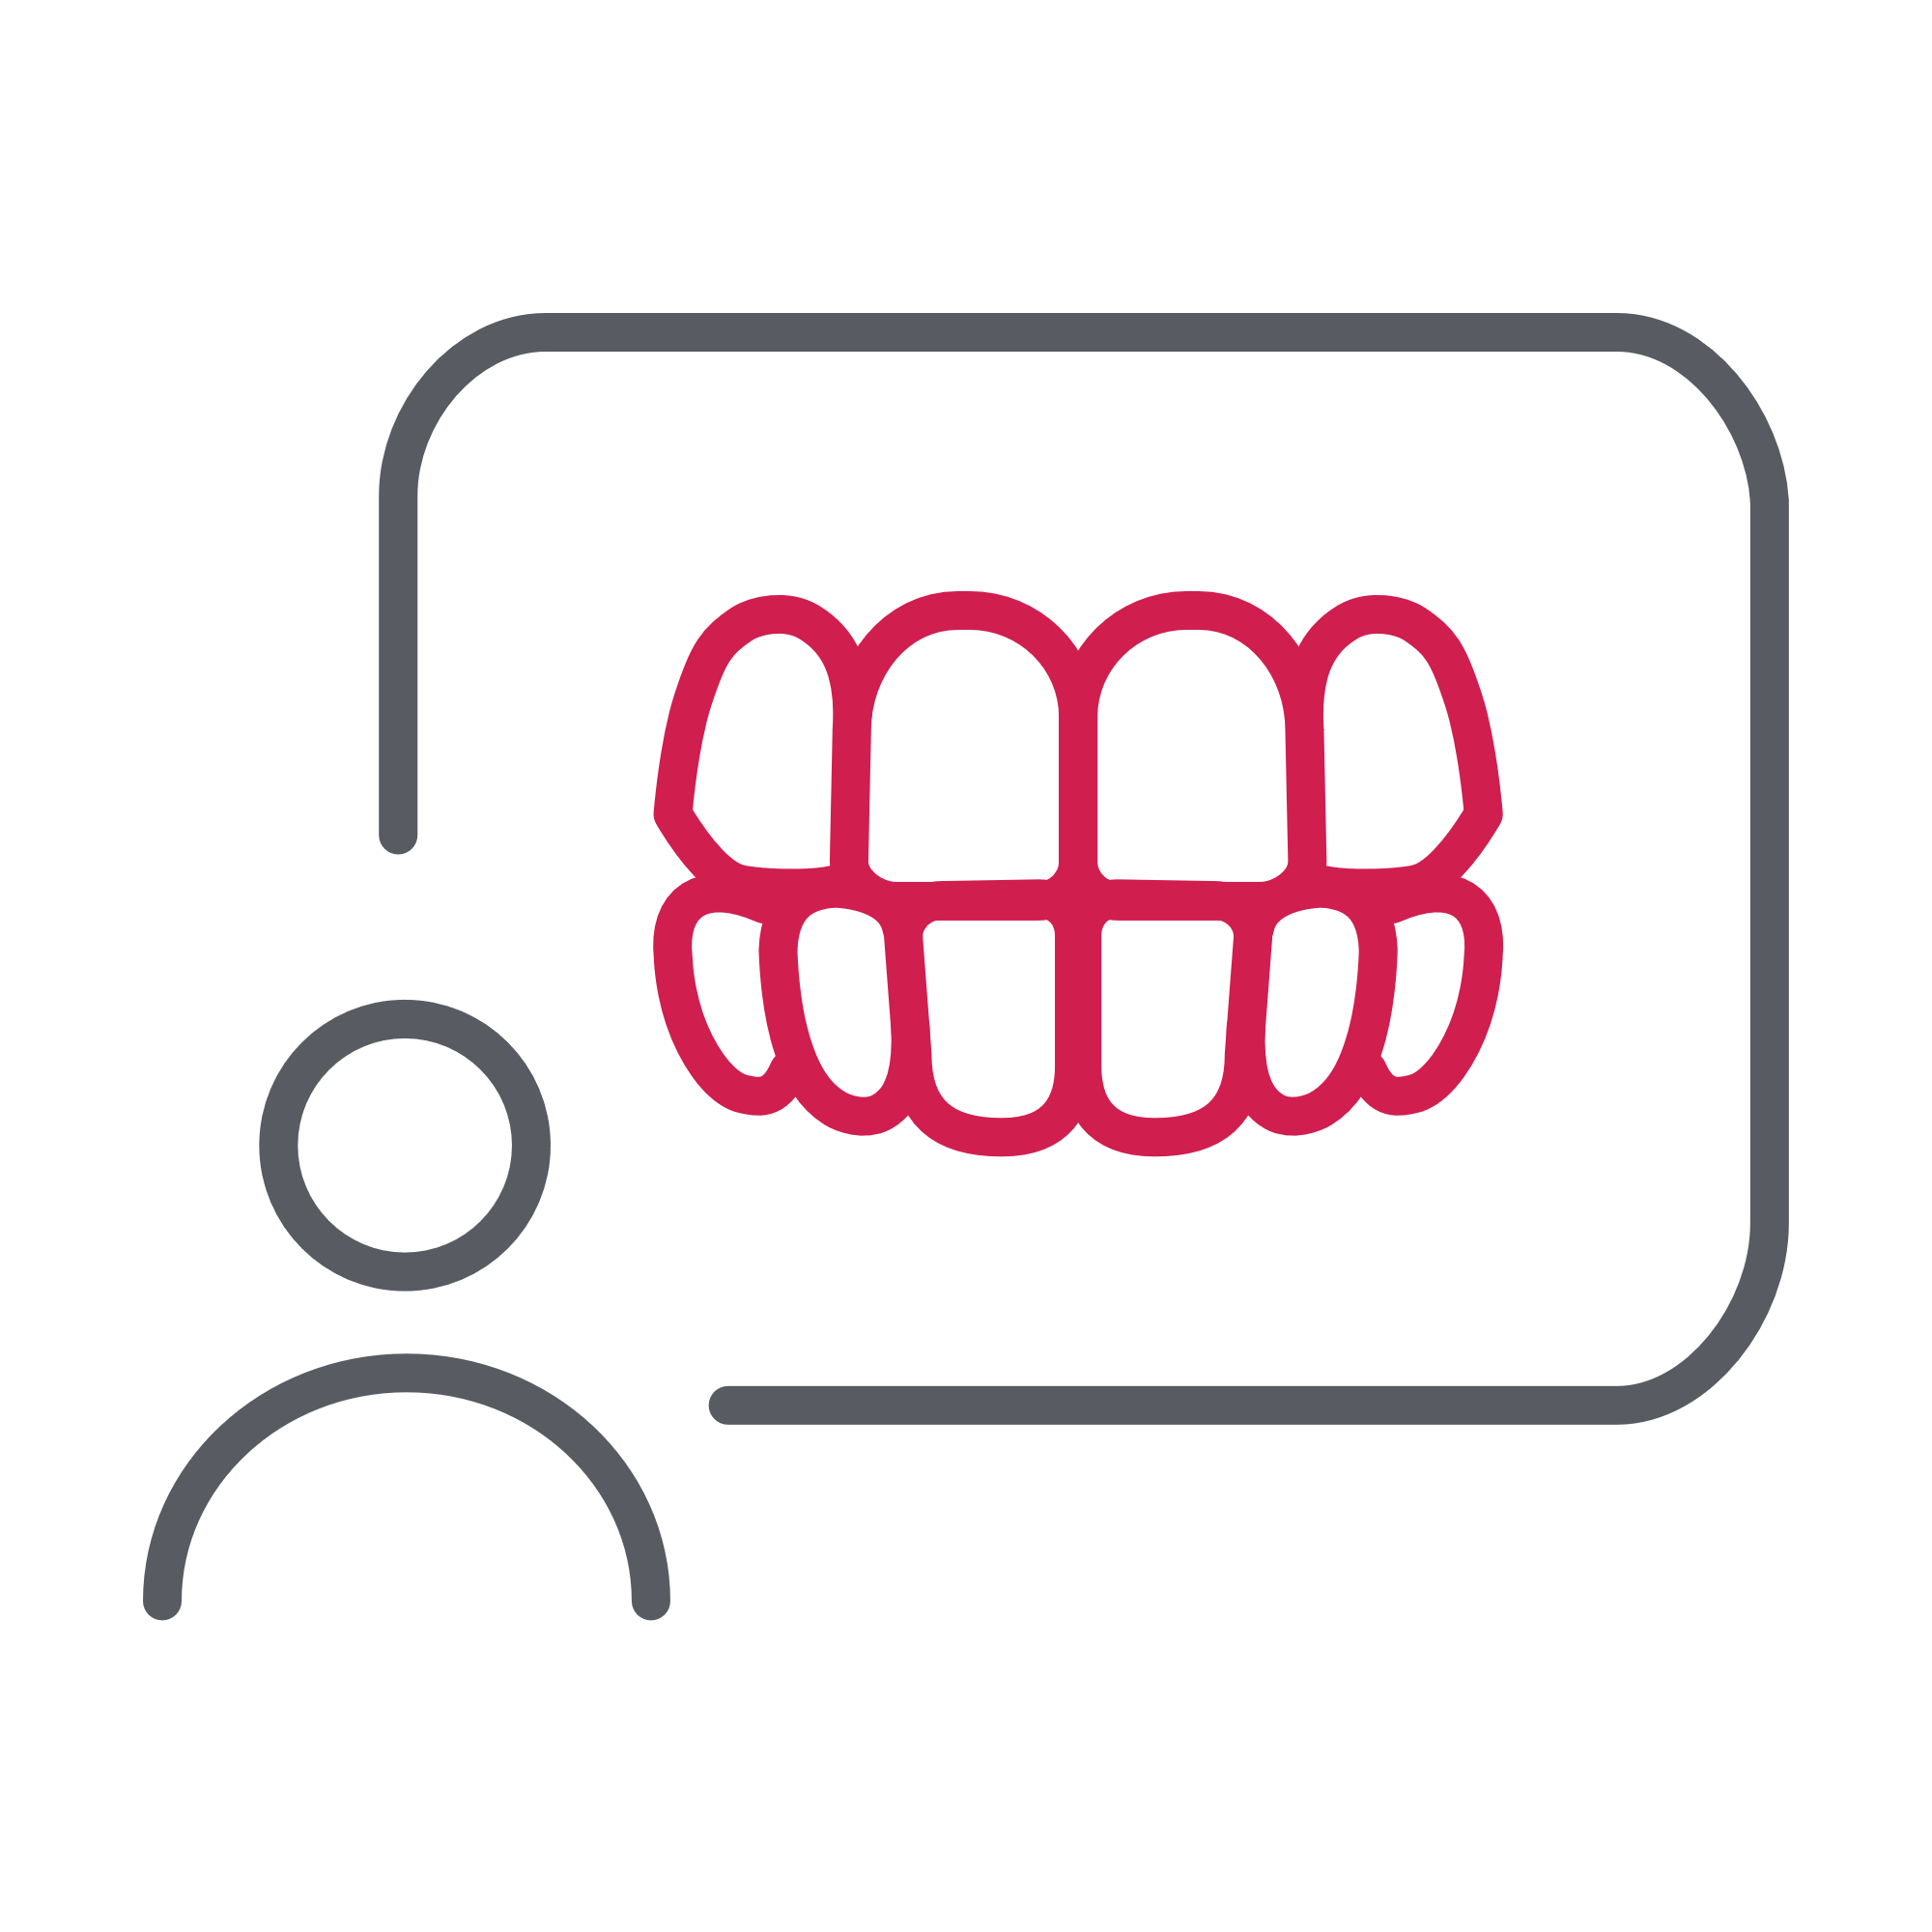
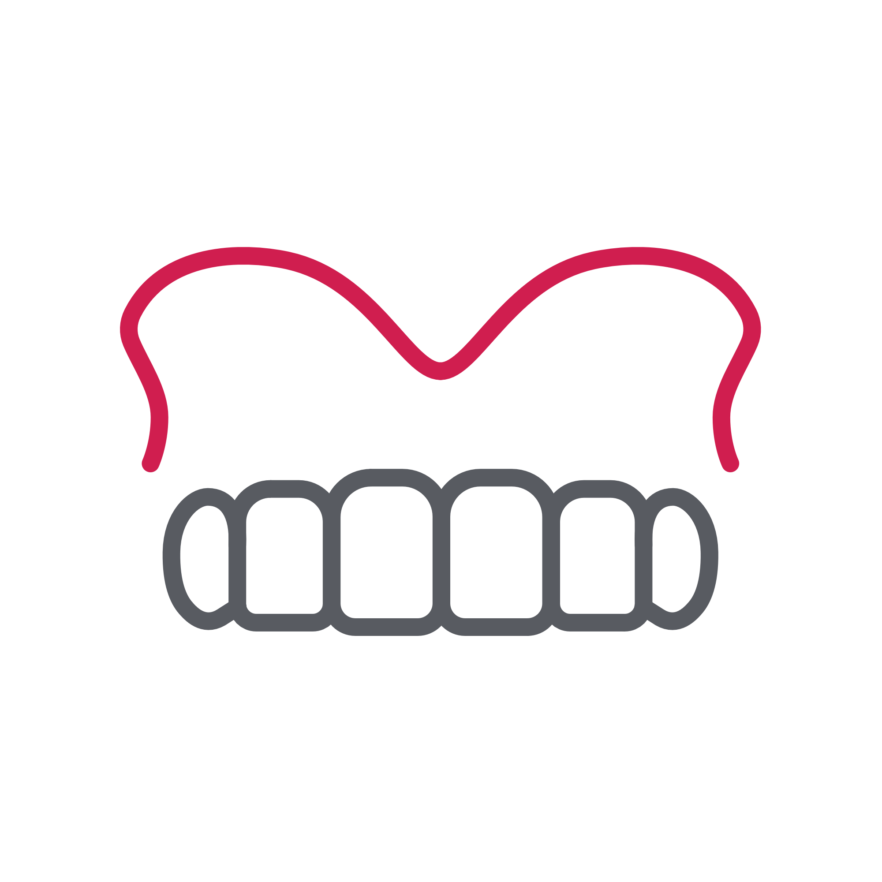
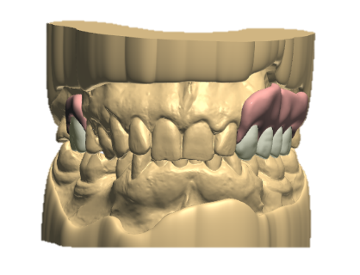
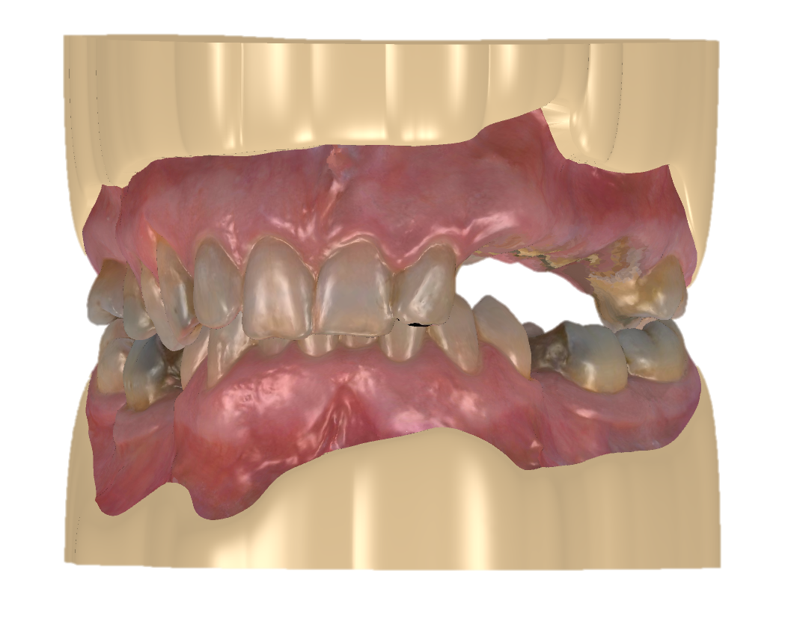
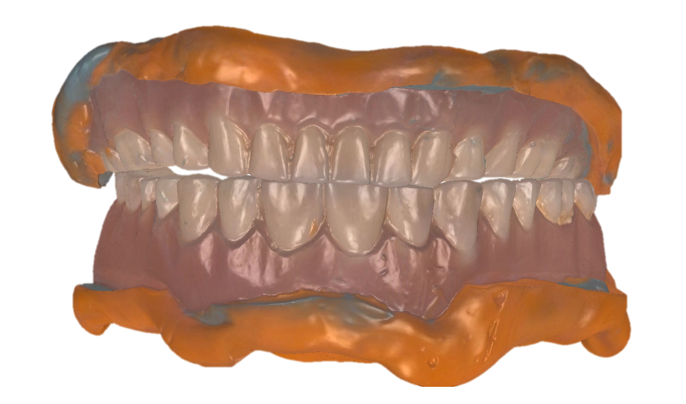
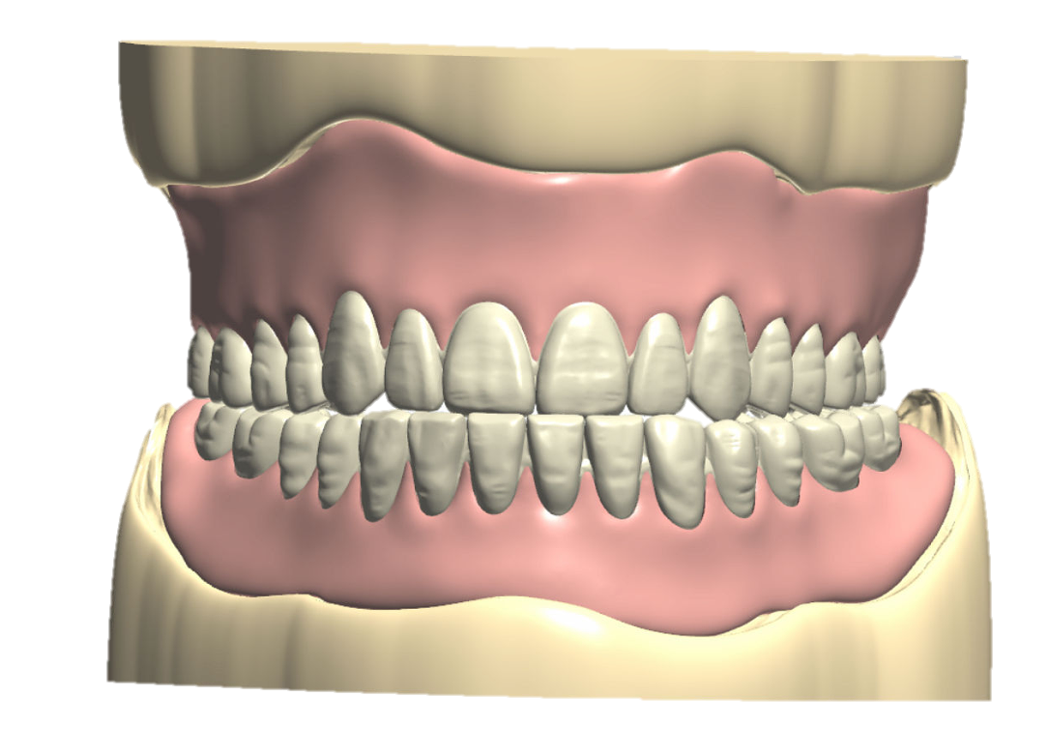
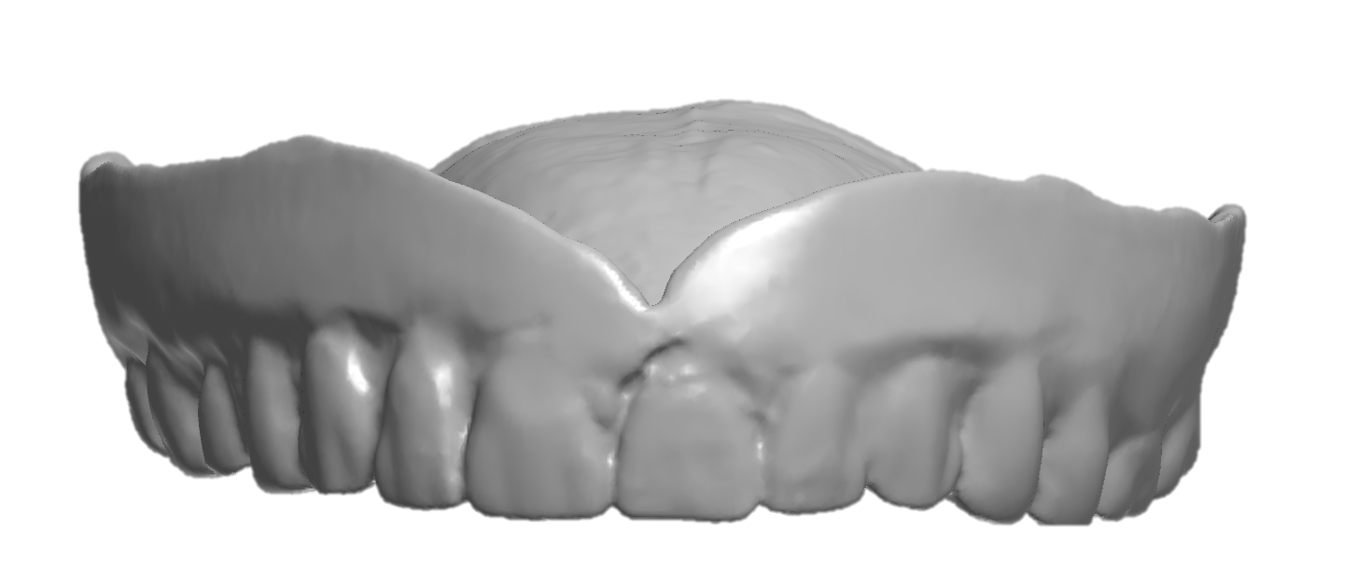
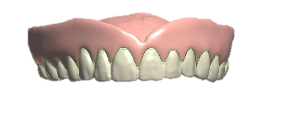
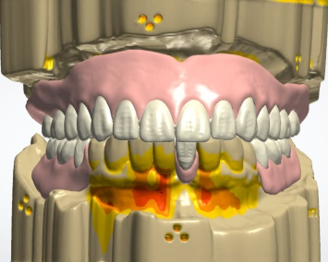
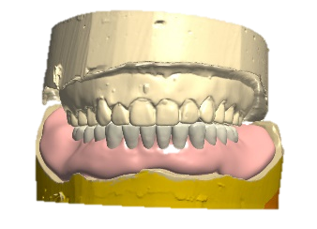
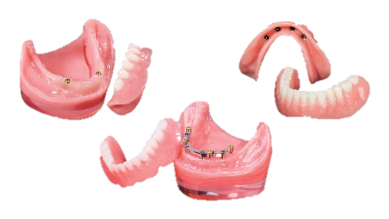
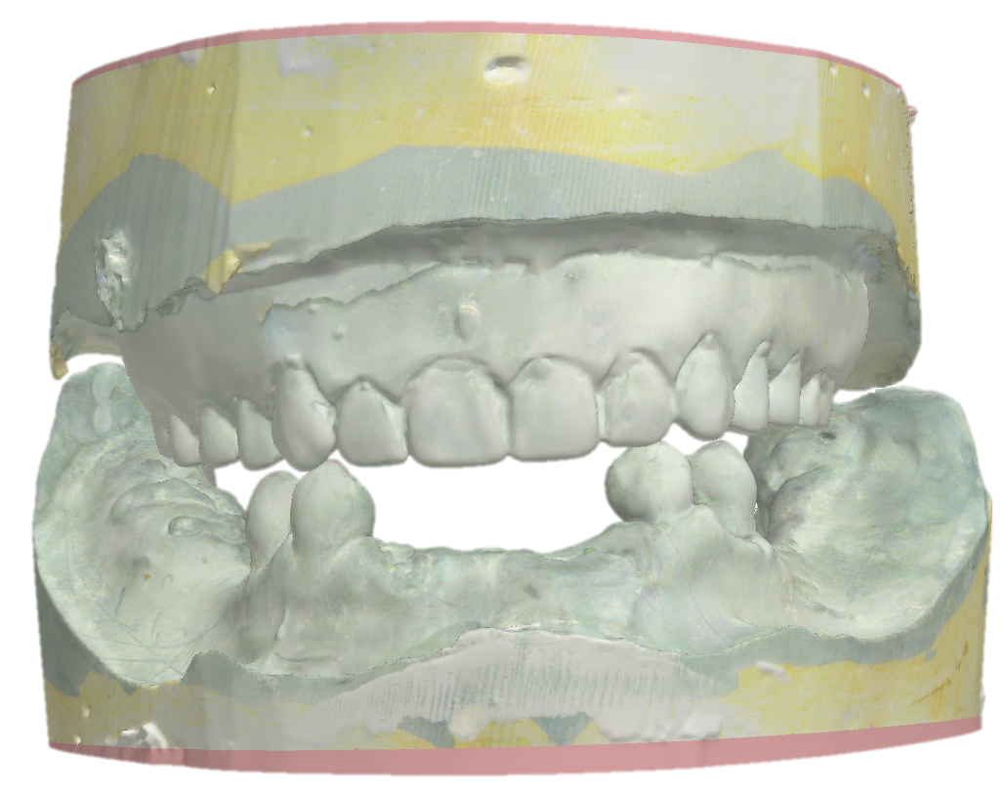
Removable Prosthetic Treatments
NO
Does the patient have existing teeth?
NO
Does the patient have existing dentures?
Full Denture without existing denture “direct to try-in”
YES
YES
Can the dentition support a partial prosthesis?
Are the dentures esthetically and functionally acceptable?
YES
Partial Dentures with or without a framework
NO
YES
NO
Is the dentition terminal?
Copy Denture
Reference Denture
YES
Full and partial dentures in the same mouth
Immediate Denture
Overdentures/implant supported dentures

Slide 2
Removable Prosthetic Treatments
Partial Dentures with or without a framework

Slide 3
Removable Prosthetic Treatments
Full Denture without existing denture, “direct to try-in”

Slide 4
Removable Prosthetic Treatments
Reference Denture

Slide 5
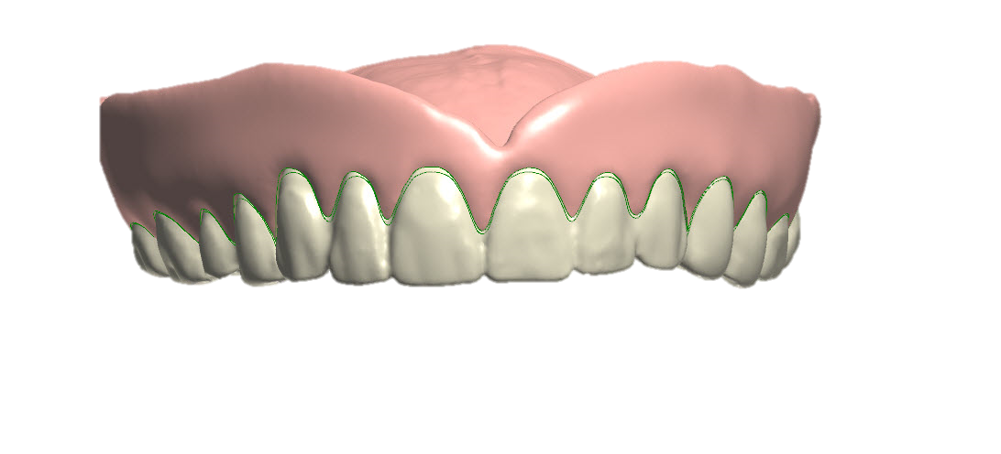
Removable Prosthetic Treatments
Copy Denture

Slide 6
Removable Prosthetic Treatments
Immediate Denture

Slide 7
Removable Prosthetic Treatments
Full and partial dentures in the same mouth

Slide 8
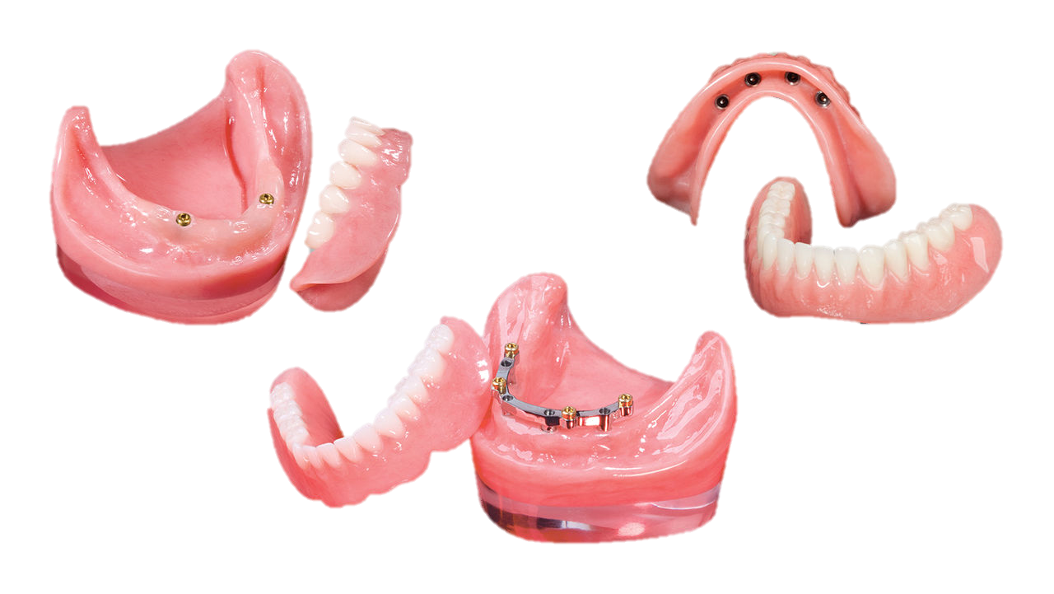
Removable Prosthetic Treatments
Overdentures/implant supported dentures

